Slide 1

Machine Learning Project
Team (20) AI

Slide 2
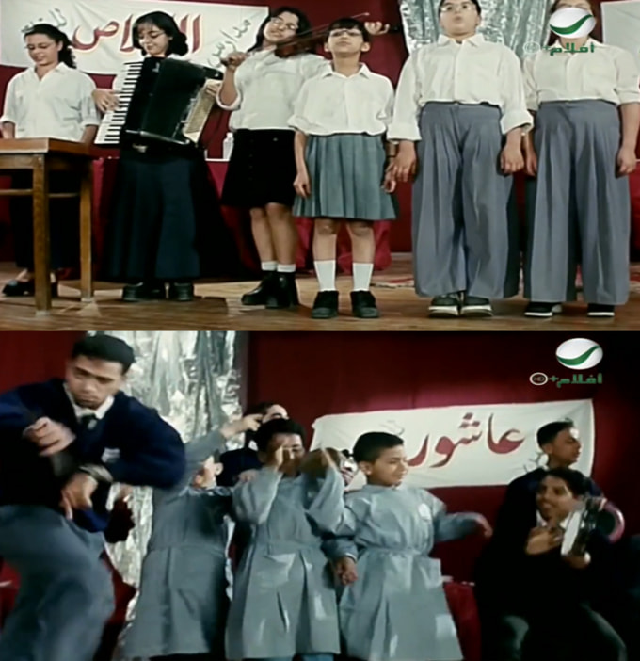
Team Members:
Amany Ashraf Ahmed Sec(2)
Mariam Hossam Gouda Sec(4)
Elsebaey Mohammed Sebaey Sec(3)
Mahmoud Mohamed Ibrahim Sec(4)
Ahmed Mohamed Hafez Sec(1)
Ali Mosaad Abdelfattah Sec(3)

Slide 3

1. Project Description
This project aims to classify whether is there is a real weather/ World disaster is happening in the world or if it’s a fake news
We will use the data which we are going to classify / test from Twitter and Tweets dataset
Then: remove the @ and # of handles and hashtags set text to lowercase
remove hyperlinks
remove stop words
remove punctuation
Simply clean the dataset

Slide 4
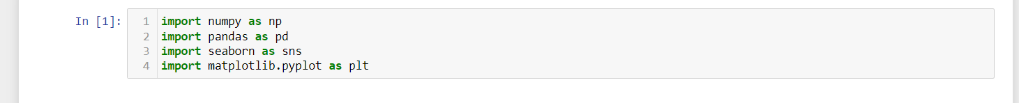
2. Importing libraries
Here we import the libraries we will use

Slide 5
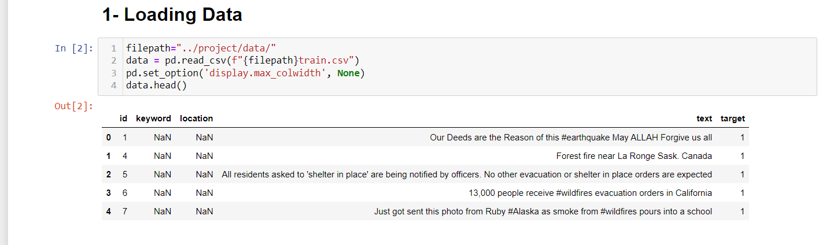
3. Loading Data
Here we load the file path for the dataset and read it so it can be used in our project

Slide 6
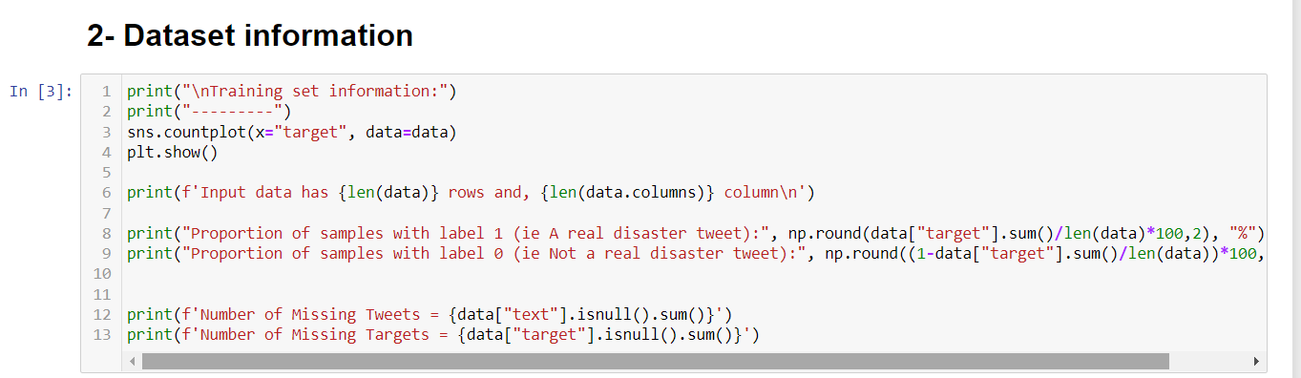
4. Dataset information
Here we read and insure that the data was red correctly

Slide 7

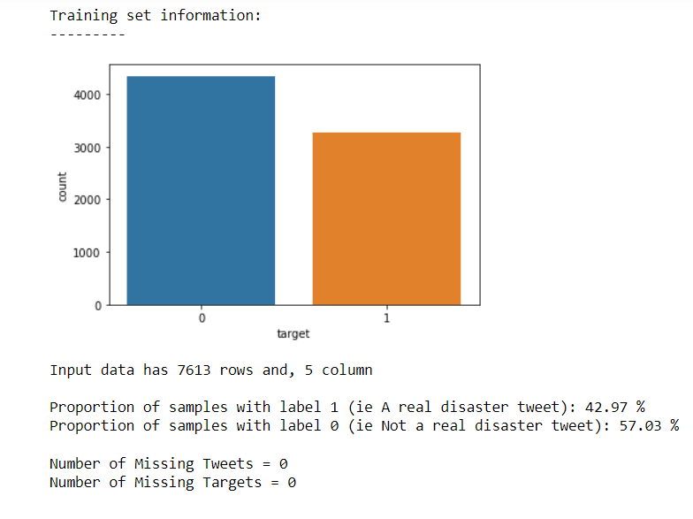
4. Dataset information cont.
الداتا اتعرضت في عمودين
Blue column for False real disaster
Red column for True Real disaster

Slide 8
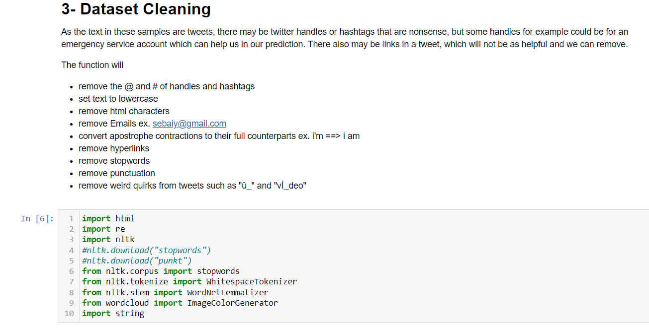
5. Dataset Cleaning
Self explained as in the picture above.

Slide 9
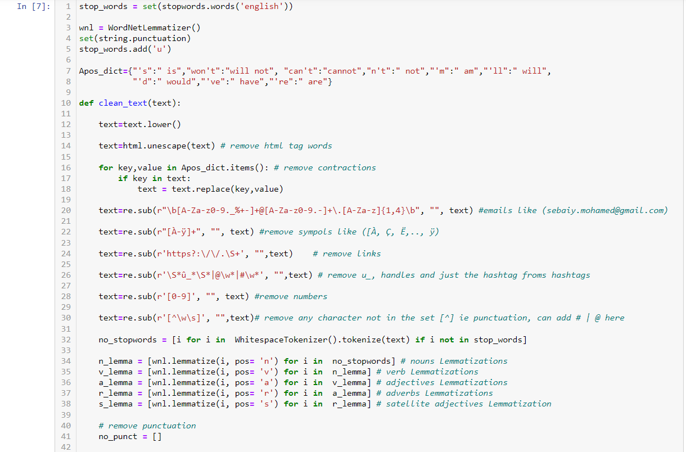
5. Dataset Cleaning cont.

Slide 10
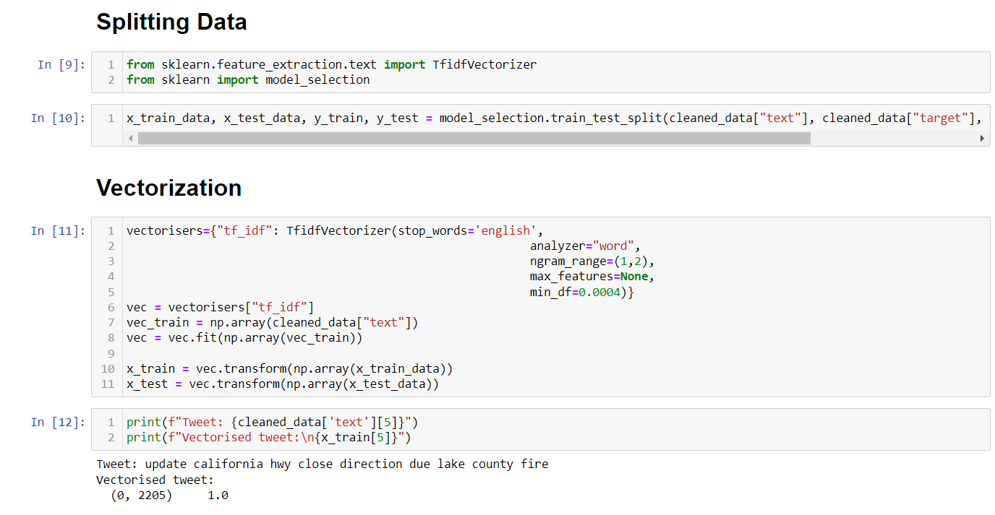
6. Splitting data & Vectorization (pre-processing)

Slide 11

7. Models used in the project
Support Vector Machine (SVM)
Logistic Regression
لا انا لسة مخلصتش
Random Forest
KNN

Slide 12
7. Models used in the project cont.
Support Vector Machine (SVM) Accuracy : 82.38%
As its used for classification or regression problems also It can handle both classification and regression on linear and non-linear data. SVMs can efficiently perform a non-linear classification using what is called the Kernel trick (separate data), implicitly mapping their inputs into high-dimensional feature spaces
Logistic Regression Accuracy: 82.1%
is used to obtain odds ratio in the presence of more than one explanatory variable. The procedure is quite similar to multiple linear regression, with the exception that the response variable is binomial. The result is the impact of each variable on the odds ratio of the observed event of interest

Slide 13
7. Models used in the project cont.
Random Forest Accuracy: 85.72%
it is used widely in Classification and Regression problems. It builds decision trees on different samples and a random forest can give you a different interpretation of a decision tree but with better performance.
KNN Accuracy: 73..52%
It can compete with the most accurate models because it makes highly accurate predictions. Therefore, you can use the KNN algorithm for applications that require high accuracy but that do not require a human-readable model.

Slide 14
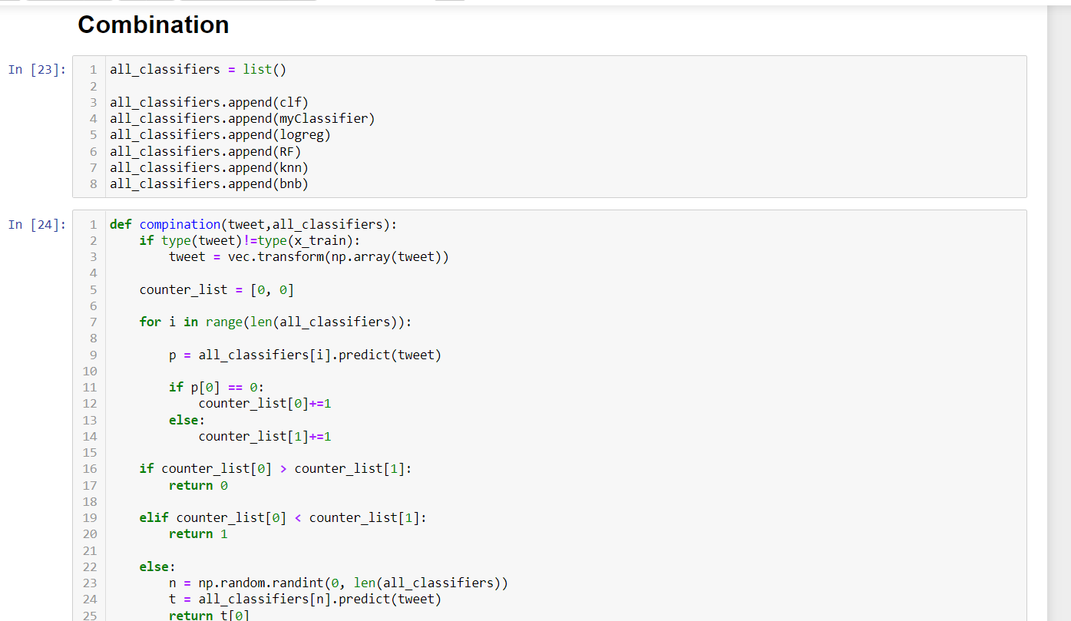
8. Combination
To combine all the previous models and then approach the best accuracy among them

Slide 15
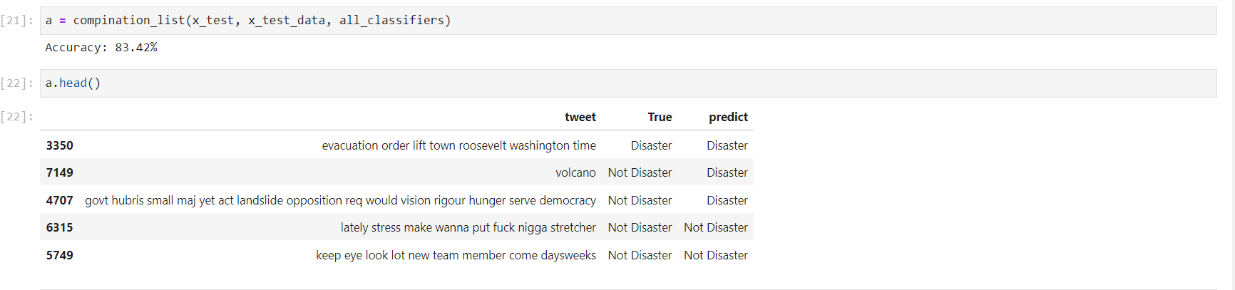
9. Evaluation and testing
Here we evaluate the combination of all the models then we reached the combined accuracy of all classifiers which is (83.42%).
Then we print some random data from the evaluated models to test the accuracy.

Slide 16

Thank you

